Slide 1
Analyzing Public Reaction to events via Google Searches
Davidson Siga
Stuti Misra
Satish Channagiri Shreenivasa

Slide 2
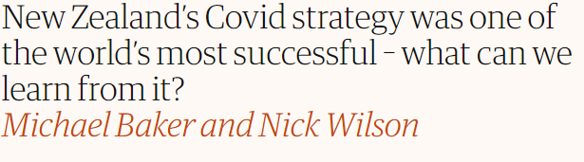
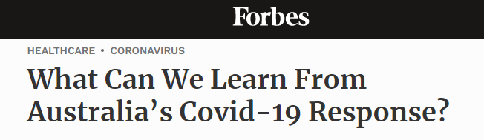
Motivation

Slide 3




Introduction
How can we measure public reaction to global events?
Would look at time taken by people to react to events occurring across the globe - “Time to react”
Understand the factors influencing ‘time to react’ for future events
In this project, we focus on time to react for a current major event, COVID, across regions
Why is it important?
Information on how quickly people are aware of events can be an essential tool for global organizations like WHO and the UN to take safety measures as soon as possible

Slide 4


Data collection
Using pytrends API we obtain Interest metric for ‘covid’ keyword at region level
We obtained covid data from ‘Our World in Data’ team consisting of Deaths, cases and tests data

Slide 5
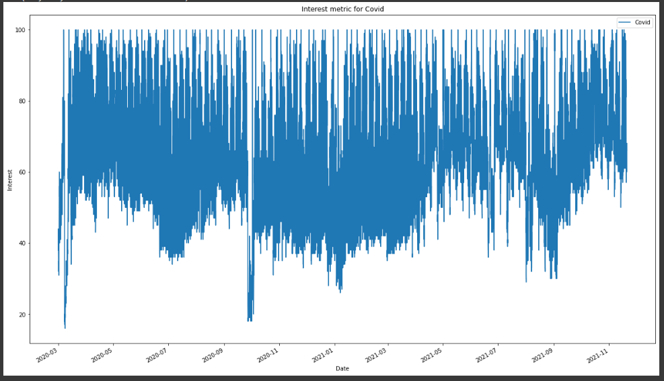
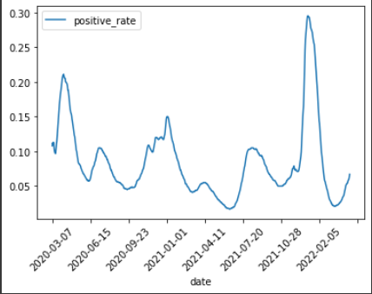
Exploratory data analysis (EDA)
We observe covid spike during March 2020 and January 2021. There is a strong correlation between actual spike observed and the search of the covid term from google trends as expected

Slide 6
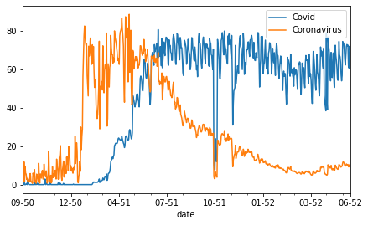
People Switched ‘Coronavirus’ with ‘Covid’, so let’s merge them!

Slide 7




Methodology for Analysis
Feature Selection
Time to react
Identify features with strong correlation with the search trend
keywords
Identify actual spikes in key factors for a region
Check for surge in google trends at global level
The difference in number of days indicates the time to react for the region/country

Slide 8
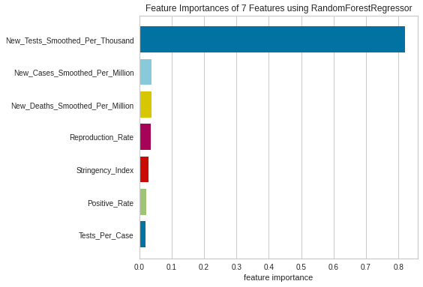
Feature Selection
X = Covid Factors , Y = Google Covid Interest
 | Metrics
Models | R-squared | MSE
Linear Regression | 0.80 | 111.07
Random Forest Regressor | 0.94 | 33.76

Slide 9
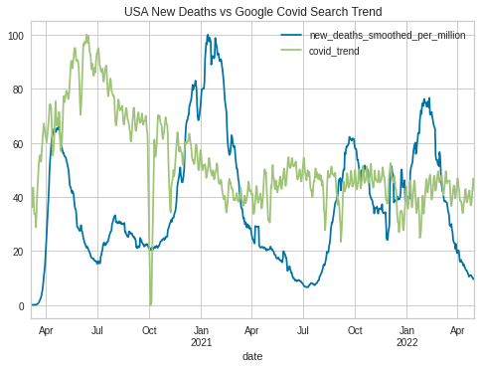
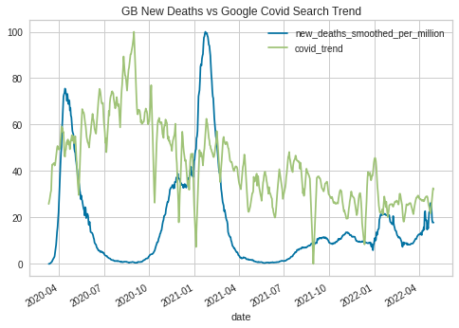
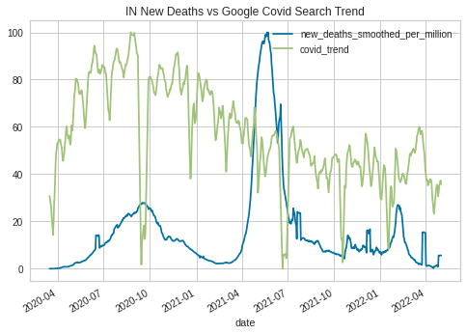
Insights - Time to react based on New Deaths
United States
United Kingdom
India
Notes:
Key insights
Time to react for USA and Great Britain were 32 and 150 days respectively
India reacted quickly to first wave by taking necessary measures resulting in lesser number of deaths. Time to react was zero.

Slide 10
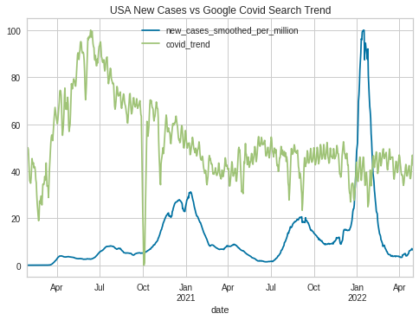
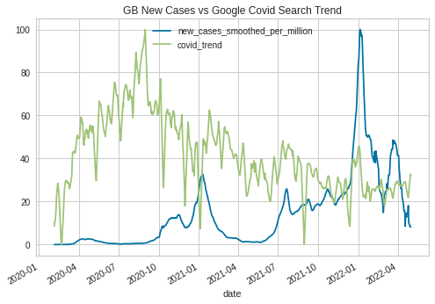
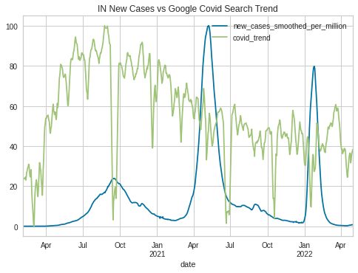
Insights - New Cases
United States
United Kingdom
India
Notes:
Key insights
Time to react for USA and Great Britain were X and Y days respectively as can be seen from the first two graphs
India reacted quickly to first wave by taking necessary measures resulting in lesser death rate

Slide 11
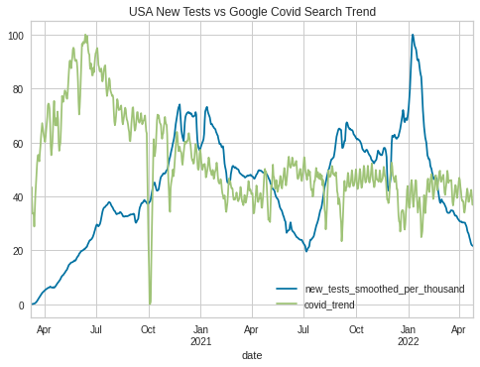
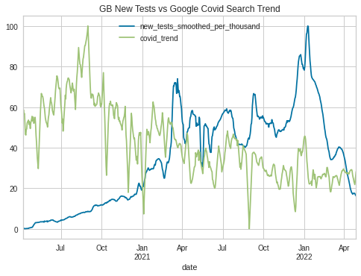
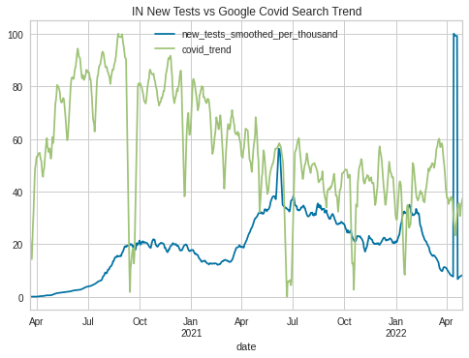
Insights - Time to react based on New Tests
United States
United Kingdom
India
Notes:
Key insights
Time to react for USA and Great Britain were X and Y days whereas the time to react for India was Z days based on new cases
As the covid scare gained traction throughout the world, the number of people getting aware about covid and getting tested increased discovering new cases

Slide 12
Conclusions
Countries | New Deaths | New Cases | New Tests
USA | 13 | 59 | 127
Great Britain | 8 | 49 | 23
India | 77 | 209 | 162
Note: Values in the matrix represents difference between First Spike in Covid Interest and First Spike in observed feature value

Slide 13
Future Work
Deep Dive : Looking at anomalies in the data
ML/Statistics : Predictive Analytics through Time Series Forecasting
Diversify : Analysis on multiple Countries and Search Terms
Width to Data : Adding additional Economic, Demographic factors to analysis
Extrapolation: Generalization to any other events

